Slide 1

DESIGN OF DIGITAL SYSTEMS
PHONE BILLING SYSTEM

Slide 2
DESIGN OF DIGITAL SYSTEMS
OBJECTIVE
TO SIMULATE A DIGITAL MODEL OF PHONE BILLING SYSTEM.

Slide 3
DESIGN OF DIGITAL SYSTEMS
OVERVIEW
THE CIRCUIT AIMS AT COMPUTING CALL DURATION AND CORRESPONDING AMOUNT.THE AMOUNT IS CALCULATED BASED ON PRESET CALL RATE.

Slide 4
DESIGN OF DIGITAL SYSTEMS
COMPONENTS REQUIRED
BASIC GATES:
TO IMPLEMENT THE BASIC LOGICAL OPERATIONS ALONG WITH COUNTERS
D FLIP FLOPS:
TO DESIGN COUNTERS.
SEVEN-SEGMENT DISPLAY:
USED FOR DISPLAYING PRICE AND CALL DURATION

Slide 5
DESIGN OF DIGITAL SYSTEMS
WORKING:
THE LOGIC BEHIND THE DESIGN IS,WHEN THE CALL BEGINS,BOTH THE TIMER AND BILL CALCULATING CIRCUITS ARE TRIGGERED SIMULTANEOUSLY BY A MASTER CLOCK. THESE CIRCUITS ARE BASICALLY COUNTERS.THEY ARE CONNECTED TO A SEVEN-SEGMENT DISPLAY. ONCE THE CALL IS TERMINATED THE TOTAL CALL DURATION AND PRICE WILL BE DISPLAYED IN SEVEN-SEGMENT FORMAT.

Slide 6
DESIGN OF DIGITAL SYSTEMS
IMPLEMENTATION:
THE TIMER CIRCUIT IS DESIGNED USING COUNTERS,WHICH ARE BASICALLY MOD-10 AND MOD-6 COUNTERS.COUNTERS ARE IMPLEMENTED USING D-FLIP FLOPS.
IN A SIMILAR WAY A BILLING MODULE IS DESIGNED USING COUNTERS,WHICH WORKS IN SYNC WITH TIMER AND PREFIXED CALL-RATE.
THE APPROPRIATE COUNTER OUTPUTS ARE CONNECTED TO SEVEN-SEGMENT DISPLAY,THUS SHOWING THE DURATION AND PRICE

Slide 7
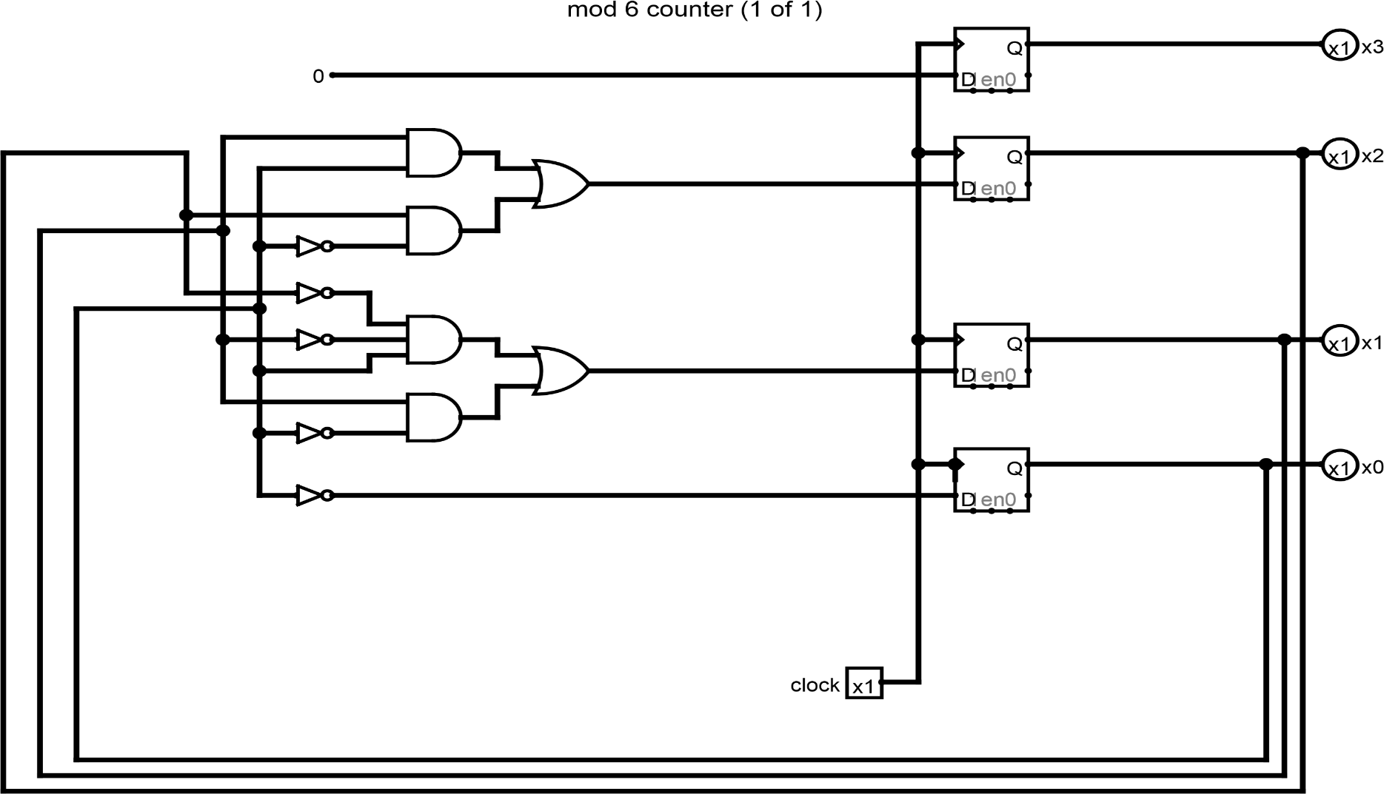
DESIGN OF DIGITAL SYSTEMS
CIRCUIT DIAGRAMS
MOD 6 COUNTER

Slide 8
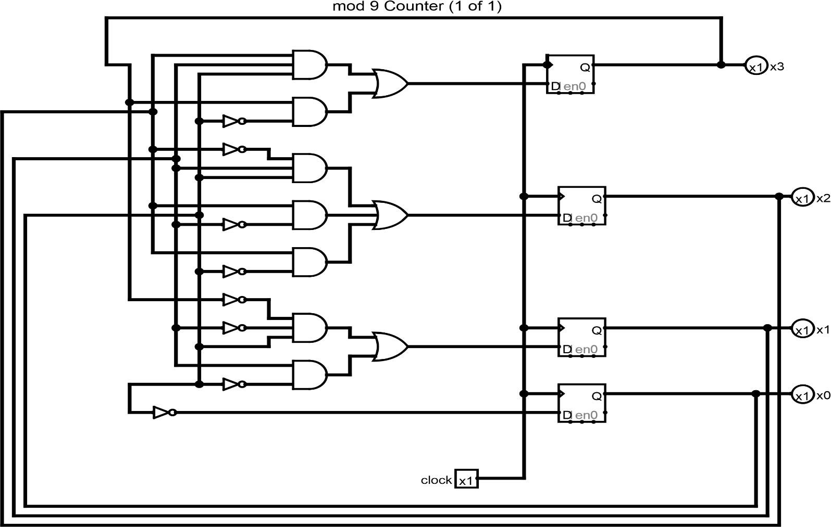
DESIGN OF DIGITAL SYSTEMS
CIRCUIT DIAGRAMS
MOD 10 COUNTER

Slide 9
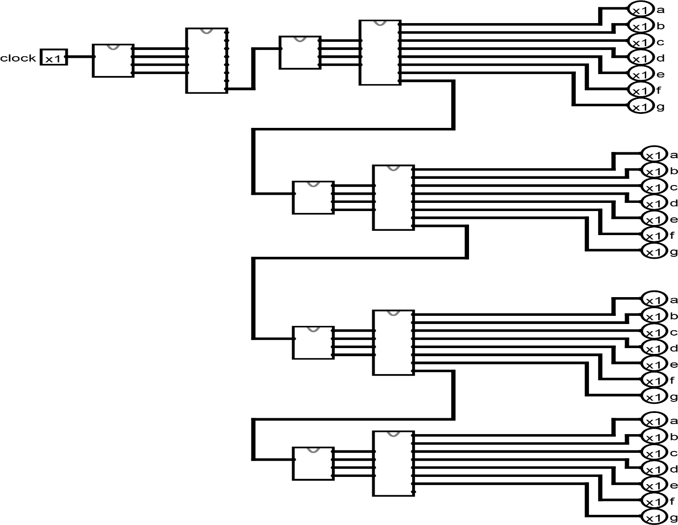
DESIGN OF DIGITAL SYSTEMS
CIRCUIT DIAGRAMS
BILL CONTROL

Slide 10
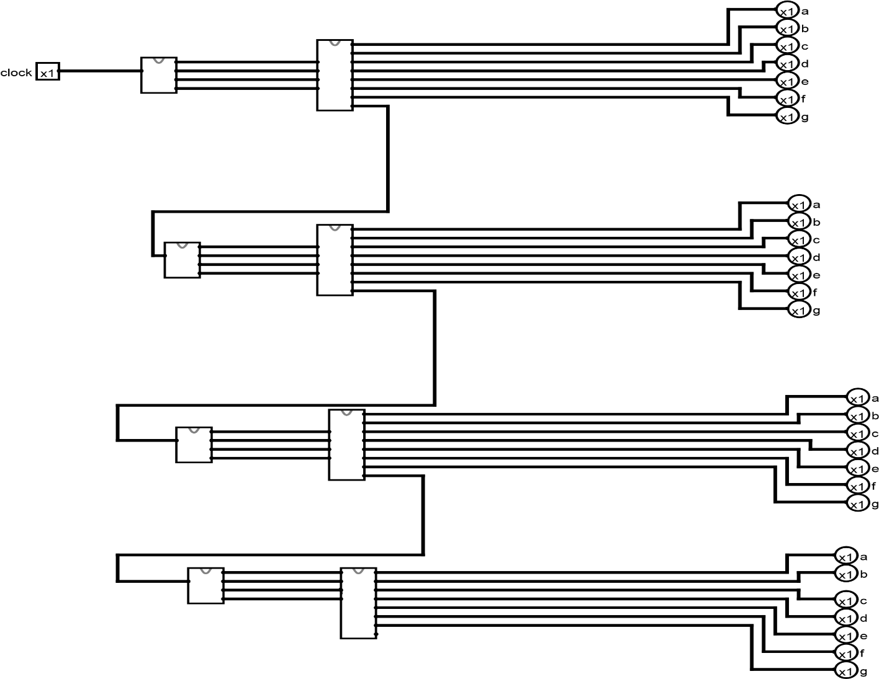
DESIGN OF DIGITAL SYSTEMS
CIRCUIT DIAGRAMS
TIMER CIRCUIT

Slide 11
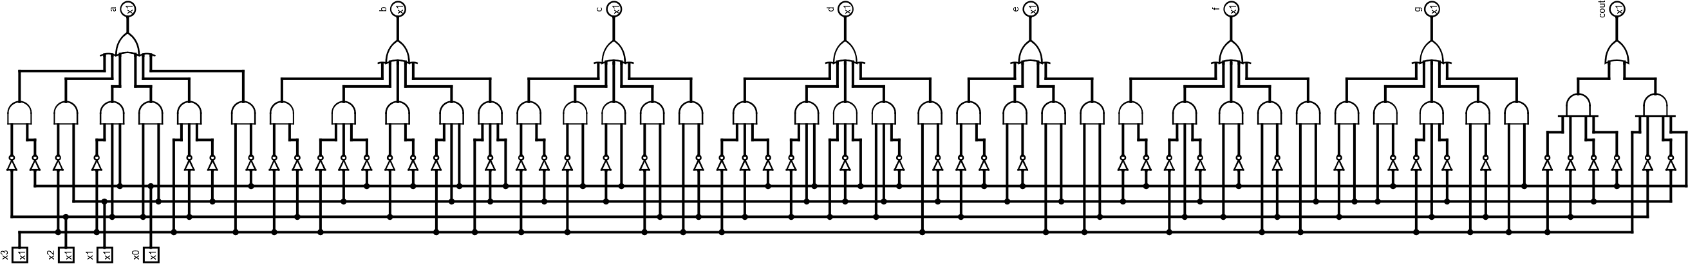
DESIGN OF DIGITAL SYSTEMS
CIRCUIT DIAGRAMS
SEVEN SEGMENT DISPLAY

Slide 12
DESIGN OF DIGITAL SYSTEMS
DEMERITS:
IN THE PRESENT DESIGN,THERE IS NO FLEXIBILITY AS THE CALL-RATE IS A FIXED ENTITY.IF IT HAS TO BE MODIFIED SOME CIRCUIT-LEVEL CHANGES HAVE TO BE INCORPORATED.

Slide 13
DESIGN OF DIGITAL SYSTEMS
APPLICATIONS:
ONE OF THE MAJOR APPLICATION IS IN PHONE BOOTHS,WHERE TRACK OF CALL DURATION AND COST IS MAINTAINED.

Slide 14
DESIGN OF DIGITAL SYSTEMS
CONCLUSION:
THE DIGITAL SIMULATION OF PHONE-BILLING SYSTEM HAS BEEN IMPLEMENTED.

